Slide 1
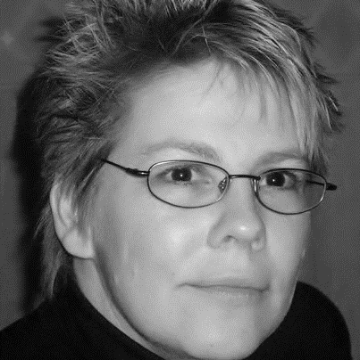
KARIN WIESLANDER
Education and certificates
Bachelor of Software Engineering , Lund Institute of Technology
TOGAF 9.1
SAFe DevOps practitioner
Professional Scrum Master PSM 1
Agile Rocket Accelerator
And more…
Skills
PL SQL
Java
DevOps
Scrum
Agile processes
Business/ IT Processes
Facilitation
Requirements Management
UX/UI
System Design
And More…
Business Analyst/Enterprise Architect/Solution Architect
Helsingborg, Sweden
Languages: SE, EN, (FR), (DK)
TOGAF 9.1 and SAFe 4 DevOps certified Business Analyst/Enterprise- and Solution Architect with strong problem-solving and communication skills and a passion for learning and excellence.
I see a challenge in helping customers and techies meet in a common understanding and help them work well together.
My emphasis lies on requirement engineering, documentation, business and software processes, software design, project planning/management, UX/UI, and Agile processes. I have worked many years with IT systems at a major international retail company, including such fields as supply chain, retail, orders, delivery planning and HR as business analyst, ITSA and solution architect.
I am an extremely fast learner with a passion for knowledge in all fields and an excellent communicator, both verbally and in writing, with many years of experience in customer service.
I am a hard-working, high-energy performer that moves easily from overview to specifics. She can often find new ways of looking at an old problem. She sees a challenge in helping customers and developers meet in a common understanding.
2019-05 -2019-08 IKEA IT At IKEA – Talent Recruit. Requirements, Test and documentation. Project to implement system to recruit and onboard co-workers. requirements, BAT test, Integrations.
2019-04 IKEA IT At IKEA - Payments. Documentation and handling of test environments.
2016-05- 2018-05 IKEA Retail Services As Business Analyst in transformation of large store system (MHS). Creating a new application for forecasting in stores. Store Location Management, Store replenishment, Store sales forecasting, Requirements, BAT test, integrations.
2015-10 - 2016-04 IKEA IT Delivery AB As Business Analyst in project to automate ordering and deployment of test environments. Requirements, BAT test, architecture.
2014-03 - 2015-04 IKEA of Sweden AB As BA and SA in project creating new system for planning of discontinued articles. Requirements , UI Design and System Design.
And more …

